Slide 1


Direct Donations
Making donations efficient and transparent
Team: Sell-outs
Abby Shen, Annie Sun, Dani Zhao, Tamara De Mel
Accenture Hackathon 2019
Notes:
Hi we are the sell outs and we would like to present to you our blockchain based solution to make charity donations more efficient and transparent.

Slide 2
Problem Identification
PROBLEM 01
Inefficiency
The charity acts as a middle man that connects and organizes the resources needed to provide humanitarian aid to people in need.
PROBLEM 02
Non-Transparency
The cashflow is only accessible to the charity. Donors cannot track how the money is spent.
PROBLEM 03
No Verification
Donors are unable to verify whether the people in need have received the help promised by the charity.
Notes:
Our team decided to tackle problems related to charities and humanitarian aids. According to a research done by the fundraising organization classy, some of the top reasons that are preventing potential donors from giving are the fear of regret, relating to distrust in charities, and low donor efficacy, such as the thought of “donating 1 dollar doesn’t do much anyways”.
Who here has donated to charities before? Do you know exactly where your money goes and who benefits from them? I think we have all seen it in the news, where charities take donations but use it for their own good. A survey from an Australian media outlet states that 81% of respondents didn‘t know how much of their donation reached a charity’s beneficiaries, but over 90% of them wanted to know. Not all charities are evil, but some of them major problems that are stopping me and you from donating are transparency and long periods of time before verification.

Slide 3


Current Donation Process
Finally, the beneficiaries receive the humanitarian aid intended by the donors
Charities launch fundraising campaigns
Donations are accounted by the charity administration
.
Local organizations physically distribute aid and services to those in need
Charities contact services to arrange service logistics
Charities pay organizations & their workers before provision of service
& then
Payment
Provision of Services ​
Notes:
As you can see, the current donation process is time consuming and inefficient. Charities work as a middle man that connects all the different resources, which can be exploited by workers for their personal gain. Any steps after the donation is also non-transparent to the donors, further increasing the distrust between donors and the charity.
As you can see, the current donation process is time consuming and inefficient. Charities work as a middle man that connects all the different recourses. They arrange for delivery times, payments of goods, accounting and auditing of cashflow. It is this process and dependability on the charity that gives them the chance for possible corruption. This also incurs extra expenses paid to the administration workers.

Slide 4
Goals & Impact
Reduce Corruption
Increase Trust
Speed Up the Help
Ensure your kindness is sent to the right people
The charity and donors are able to establish a sustainable and long term relationship between the
Quickly deliver aid to those in need
Notes:
____3minute
From identifying the problems, we've developed three goals from our use of blockchain: Reduce corruption, increase trust between charities and donors and speed up the help from an automated process.

Slide 5


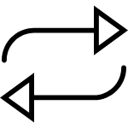
The Edge of Our Donation Model
.
Differentiation from competitors
Automating the administrative process​
Not only do we use blockchain for transparency, as competitors do, we use it to increase efficiency
Notes:
Our idea is basically an upgrade to the current donation model.
Other companies have started to utilise blockchain to improve transparency, such as what Alice.si is doing. Our technology not only includes this, but goes one step further by automating the administrative process. This reduces processing time of digital donations, to reduce overhead costs and prevent human-made inconsistencies.

Slide 6
Charity Re-Model using Blockchain
Accumulating
funds
Smart Contract
Delivery
Verification
Notes:
These are the four main components that make up the back bone of our blockchain model: Accumulating funds, smart contract, delivery and verification.

Slide 7
Charity Re-Model using Blockchain
$
$
$
Logistics
Smart Contract
Accumulation
Verification
Payment made
Transaction Complete
Notes:
Information about donations are stored in a primary block. When this amount accumulates to the budgeted target of a project, the chain of logistics, for example delivering vaccines, will begin and now the charity’s main role is to verify that the end solution has occurred successfully. This meets the conditions of the smart contract and prompts the payment to be made automatically, thus completing the transaction.
Let me walk you through our game changing way of donating:
First, feasible and budgeted jobs are created by the charity: for example, planting 50 trees, building 1 well and so on. Let’s take the example of sending 100 vaccines to children in need. Donors would donate money to the primary block, and when the total amount reaches the budgeted target, the smart contract is activated.
Then, the smart contract will prompt the contractors, sellers and buyers involved to start the logistics needed to deliver the product. This eliminates the need for the charity to be in between the transactions, hence increasing efficiency and removing admin costs. Due to the nature of blockchain technology, each transaction would be verified by the parties involved to ensure smooth delivery.
Now, the main role of the charity is to verify the final delivery of the product. This gives the charity more time to focus on affirming and providing donors with evidence that their help has made a difference. Once the charity and other stakeholders confirm the end delivery, payment is executed by the smart contract, and transaction would be complete.

Slide 8
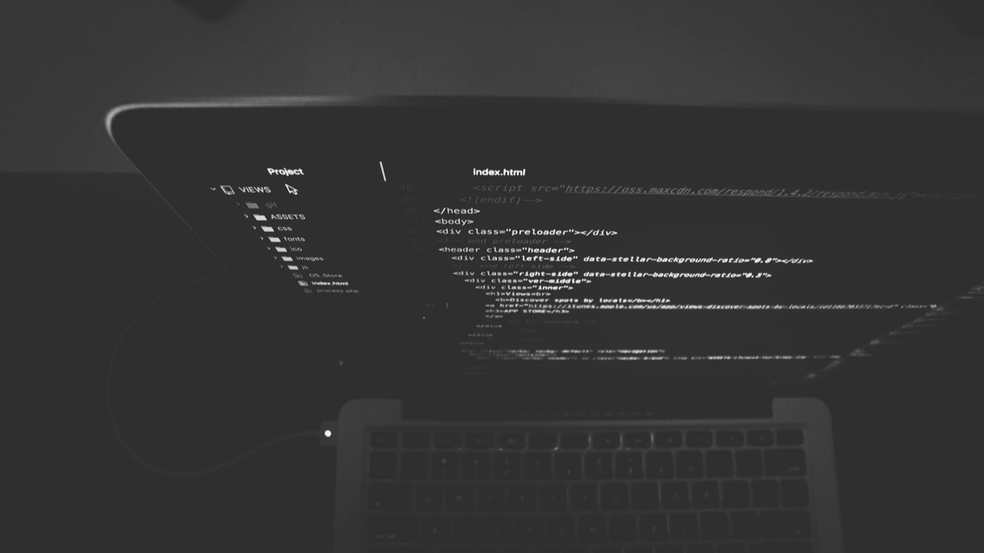
Prototype Live Demonstration
Notes:
This use case is based on verification of the service. In this case it is the delivery of 100 vaccines.
The UI is modelled by the visualisation of the blockchain seen in the previous slides.
Our demo demonstrates the only step that the charity, who we are pitching to, would do - showing how easy their function is - to only VERIFY THAT THE DONATION HAS GONE INTO A SERVICE.
___7minute
This use case is based on verification of the service. In this case it is the delivery of 100 vaccines.
The UI is modelled by the visualisation of the blockchain seen in the previous slides.
Our demo demonstrates the only step that the charity, who we are pitching to, would do.
The first page represents the verification step, that can only be submitted by the charity, as a trusted party. The pop-up is an immediate product of the completion of the smart contract, releasing the withheld money from the charity to the service providers.
The demo demonstrates how easy the charity’s function is, such that they can focus less on admin and more on the important stuff - like donations and verification.

Slide 9
Blockchain Usage
Automation
Versatility
Security
Corruption Prevention
Transparency
Notes:
The use of blockchain technology enables humanitarian projects to kickstart faster with less administration processes. And this technology can be implemented repeatedly on any projects that have a set budget, for example plating 100 trees, building 1 emergency shelter. As mentioned before, donors would like to know how much of their donations reach the beneficiary, the transparency provided by the blockchain can clear their uncertainties. Also, because payment is made after verification through a smart contract, the charity and donors’ money are both secure.

Slide 10
Business Value
Business Viability
Monetary Value
Notes:
The expected effect from establishing trust, and providing real-time results to donors, is that donors will donate more frequently in larger sums, and donate again in the long term. Our technology also removes the expenses for charities to hire unnecessary workers. This money can be reinvested into fundraising campaigns, or go back to the people in need. Most importantly, we save an invaluable resource – time, and aid can reach people faster.
We expect that the gain from implementing this technology will break even with the expenses incurred to develop it. It would also require a low maintenance cost once the base is set up. We are sure that the benefits will outweigh the costs and hence this would be a very desirable model that charities would want to work with.
The expected effect from establishing trust, and providing real-time results to donors, is that donors will donate more frequently in larger sums, and in the long terwhich will increase incentives for donors to donate again in the long term. Our technology also removes the expenses for charities to hire workers between the logistics. This money can be reinvested into fundraising campaigns, or go back to the people in need. Most importantly, we save an invaluable resource – time, and aid can reach people faster.
We expect that the gain from implementing this technology will break even with the expenses incurred to develop it. It would also require a low maintenance cost once the base is set up. We are sure that the benefits will outweigh the costs and hence this would be a very desirable model that charities would want to work with.

Slide 11
Social Impact
We provide charities with better means to achieve the sustainable development goals more efficiently
We enable the donors to feel more involved in making a difference in the world by their actions and kindness
We make sure that the people in need are provided with the help they deserve
We believe in a better world and a better society through the work of organizations and charities
Notes:
Our technological solution aligned with the sustainable development goals outlined by the UN. It enables charities to be more efficient, and distribute their efforts into fundraising and services rather than administrative processes. We are truly hoping to improve the wellbeing of humanity through blockchain technology.

Slide 12
Questions

